Slide 1


Mis perfiles Cura 3.0.4
Mis perfiles Cura 3.0.4 by Federico Coca
is Licensed under a Creative Commons Attribution-ShareAlike 4.0 International License
9

Slide 2
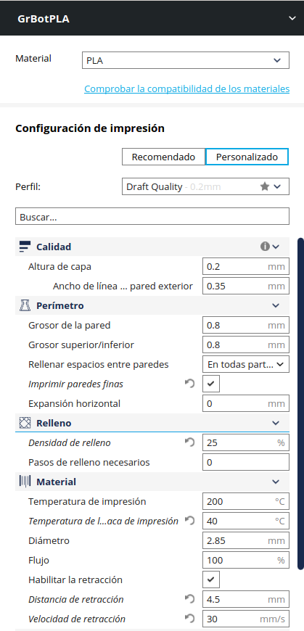
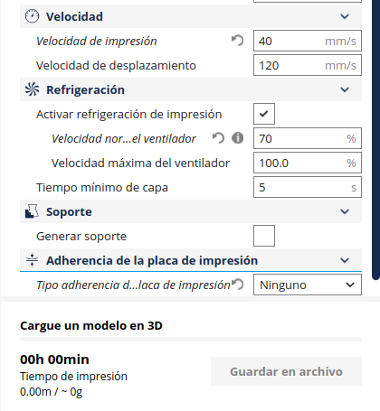
Mis perfiles Cura 3.0.4 by Federico Coca
is Licensed under a Creative Commons Attribution-ShareAlike 4.0 International License
9

Slide 3
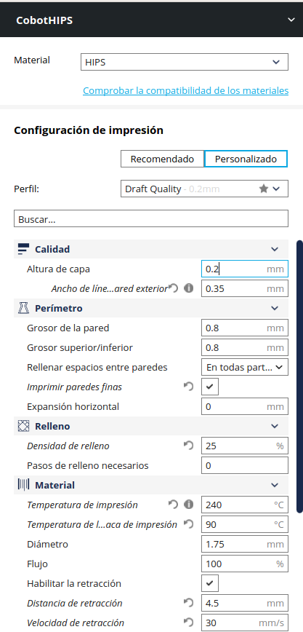
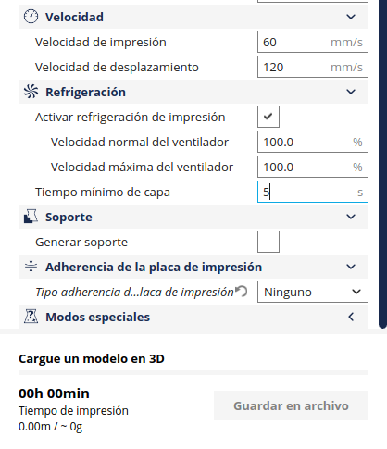
Mis perfiles Cura 3.0.4 by Federico Coca
is Licensed under a Creative Commons Attribution-ShareAlike 4.0 International License
9

Slide 4
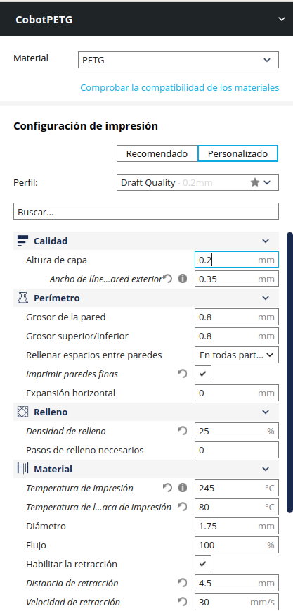
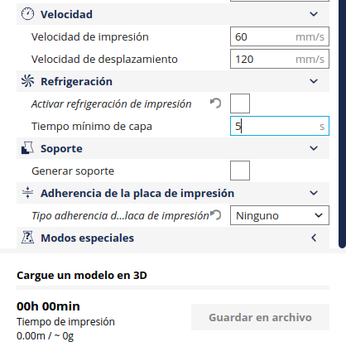
Mis perfiles Cura 3.0.4 by Federico Coca
is Licensed under a Creative Commons Attribution-ShareAlike 4.0 International License
9

Slide 5
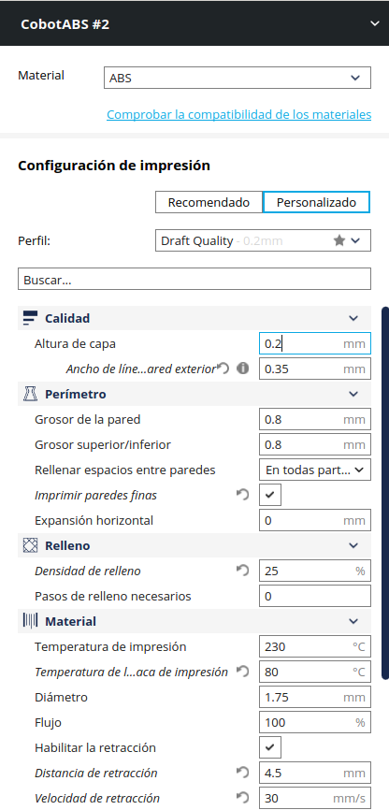
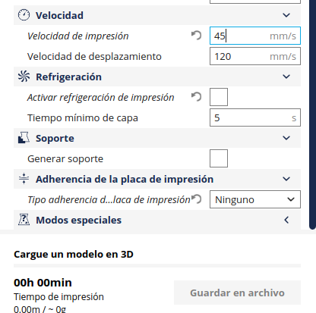
Mis perfiles Cura 3.0.4 by Federico Coca
is Licensed under a Creative Commons Attribution-ShareAlike 4.0 International License
9

Slide 6
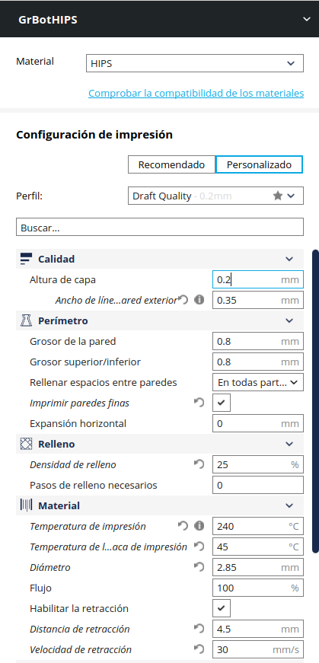
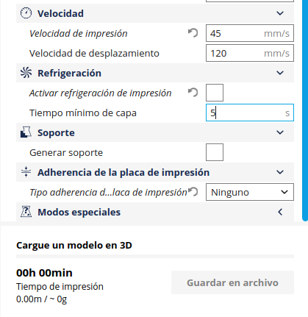
Mis perfiles Cura 3.0.4 by Federico Coca
is Licensed under a Creative Commons Attribution-ShareAlike 4.0 International License
9

Slide 7
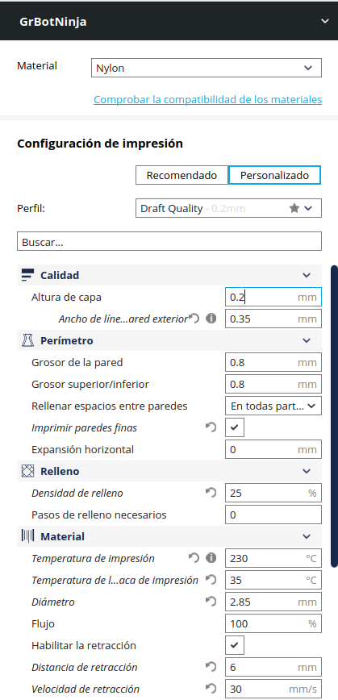

Mis perfiles Cura 3.0.4 by Federico Coca
is Licensed under a Creative Commons Attribution-ShareAlike 4.0 International License
9

Slide 8

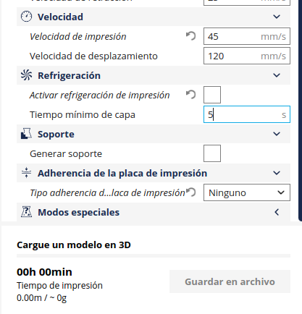
Mis perfiles Cura 3.0.4 by Federico Coca
is Licensed under a Creative Commons Attribution-ShareAlike 4.0 International License
9

Slide 9
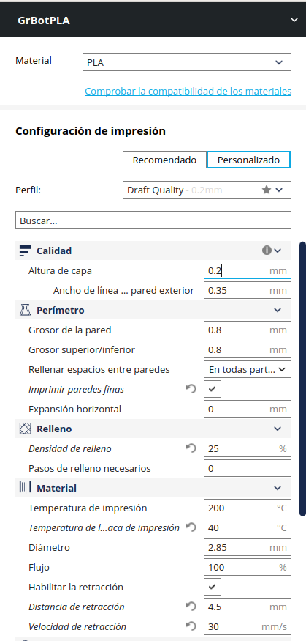

Mis perfiles Cura 3.0.4 by Federico Coca
is Licensed under a Creative Commons Attribution-ShareAlike 4.0 International License
9

